Slide 1
Title
Reporter: Your Name
Graduate Institute of Applied Physics and Department of Physics,
National Taiwan University, Taiwan
Advisor: Din Ping Tsai
Graduate Institute of Applied Physics and Department of Physics,
National Taiwan University, Taiwan
Research Center for Applied Sciences, Acadamia Sinica, Taiwan
9 February 2018
Photonics / Nano-Science & Technology Laboratory

Slide 2
Title
Reporter: Your Name
Graduate Institute of Applied Physics and Department of Physics,
National Taiwan University, Taiwan
Advisor: Din Ping Tsai
Graduate Institute of Applied Physics and Department of Physics,
National Taiwan University, Taiwan
Research Center for Applied Sciences, Acadamia Sinica, Taiwan
9 February 2018
National Taiwan University
Photonics / Nano-Science & Technology Laboratory

Slide 3
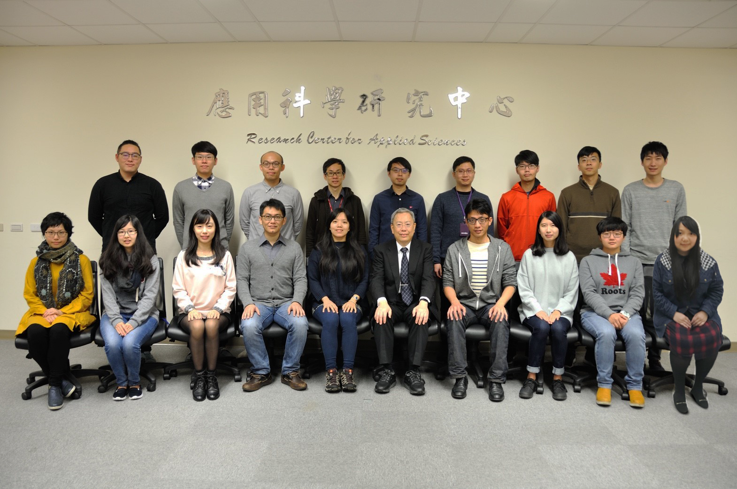
Thanks for your attention!
Google : PNSTL

